Slide 1

Data Structures
Module Number: 5.2
Module Name: Sorting and Searching (Review)
Version: DSA3
Released Date : 24-SEP-2018

Slide 2
Sorting and Searching (Review)
AIM
To equip students with various sorting techniques and searching techniques

Slide 3
Sorting and Searching (Review)
Objective of This Module
The Objectives of this module are:
To be able to explain and implement sequential search and binary search.
To be able to explain and implement Radix sort, merge sort, shell sort, quick sort, insertion sort, and heap sort.
To design, implement, and analyze sort for different applications.

Slide 4
Sorting and Searching (Review)
Outcome
At the end of this module, you are expected to:
Learn various sorting algorithms
Implement various sorting algorithms
Compare sorting algorithm performance
Learn various searching algorithms
Become aware of the lower bound on comparison based search algorithm

Slide 5
Sorting and Searching (Review)
Contents
Sorting Techniques
Searching Algorithms

Slide 6
Sorting and Searching (Review)
SORTING TECHNIQUES

Slide 7
Sorting and Searching (Review)
Sorting, what’s that then?
Sorting is the process of going from this
9 2 6 0 4 3 2 7 5
to that
0 2 3 4 5 6 7 9

Slide 8
Sorting and Searching (Review)
Examples
Do you remember the telephone directory?
Imagine if it was just in any order (random)
How long would it take you to find my telephone number?
Do you remember the dictionary?
Imagine if that was just in any order.
How long would it take to find a word, or to determine if the word was not present?
Do you ever use an online spelling checker?
How does that work?

Slide 9
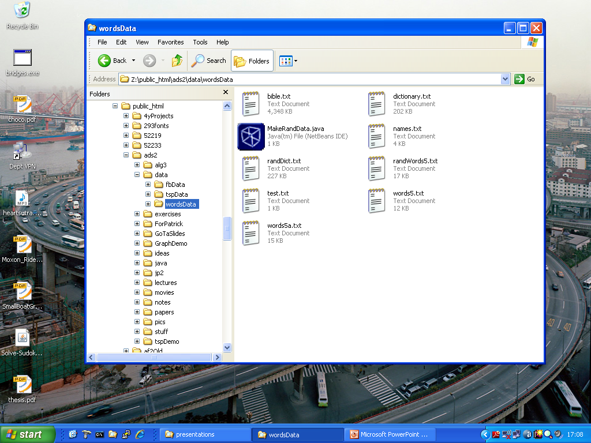
Sorting and Searching (Review)

Slide 10
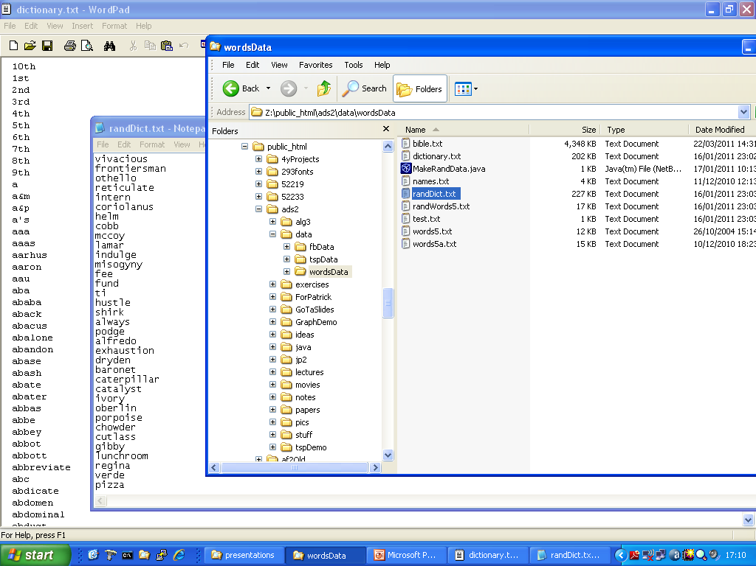
Sorting and Searching (Review)

Slide 11
Sorting and Searching (Review)
Some algorithms for sorting
bubble sort
insertion sort
selection sort Quadratic
shell sort
gnome sort
merge sort
quick sort Logarithmic
heap sort
radix sort
bead sort
Linear

Slide 12
Sorting and Searching (Review)
Insertion Sort
while some elements unsorted:
Using linear search, find the location in the sorted portion where the 1st element of the unsorted portion should be inserted
Move all the elements after the insertion location up one position to make space for the new element
45
38
60
45
66
60
45
66
79
47
13
74
36
21
94
22
57
16
29
81
the fourth iteration of this loop is shown here

Slide 13
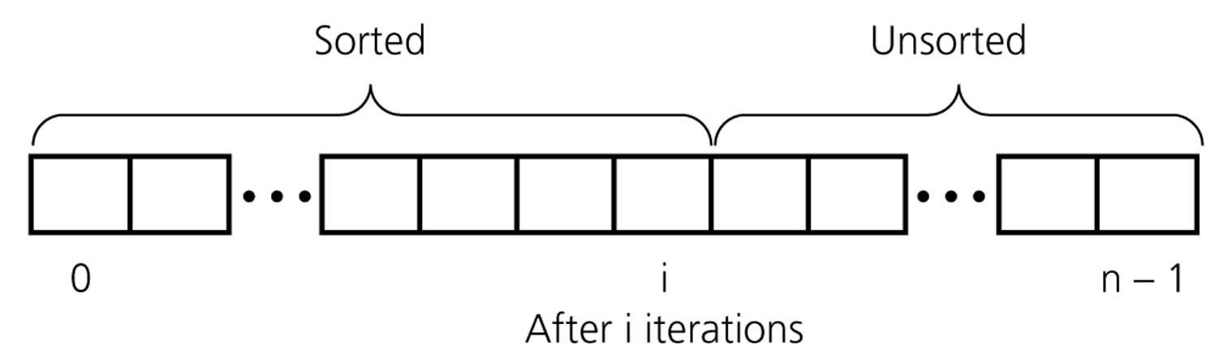
Sorting and Searching (Review)
Fig : An insertion sort partitions the array into two regions

Slide 14
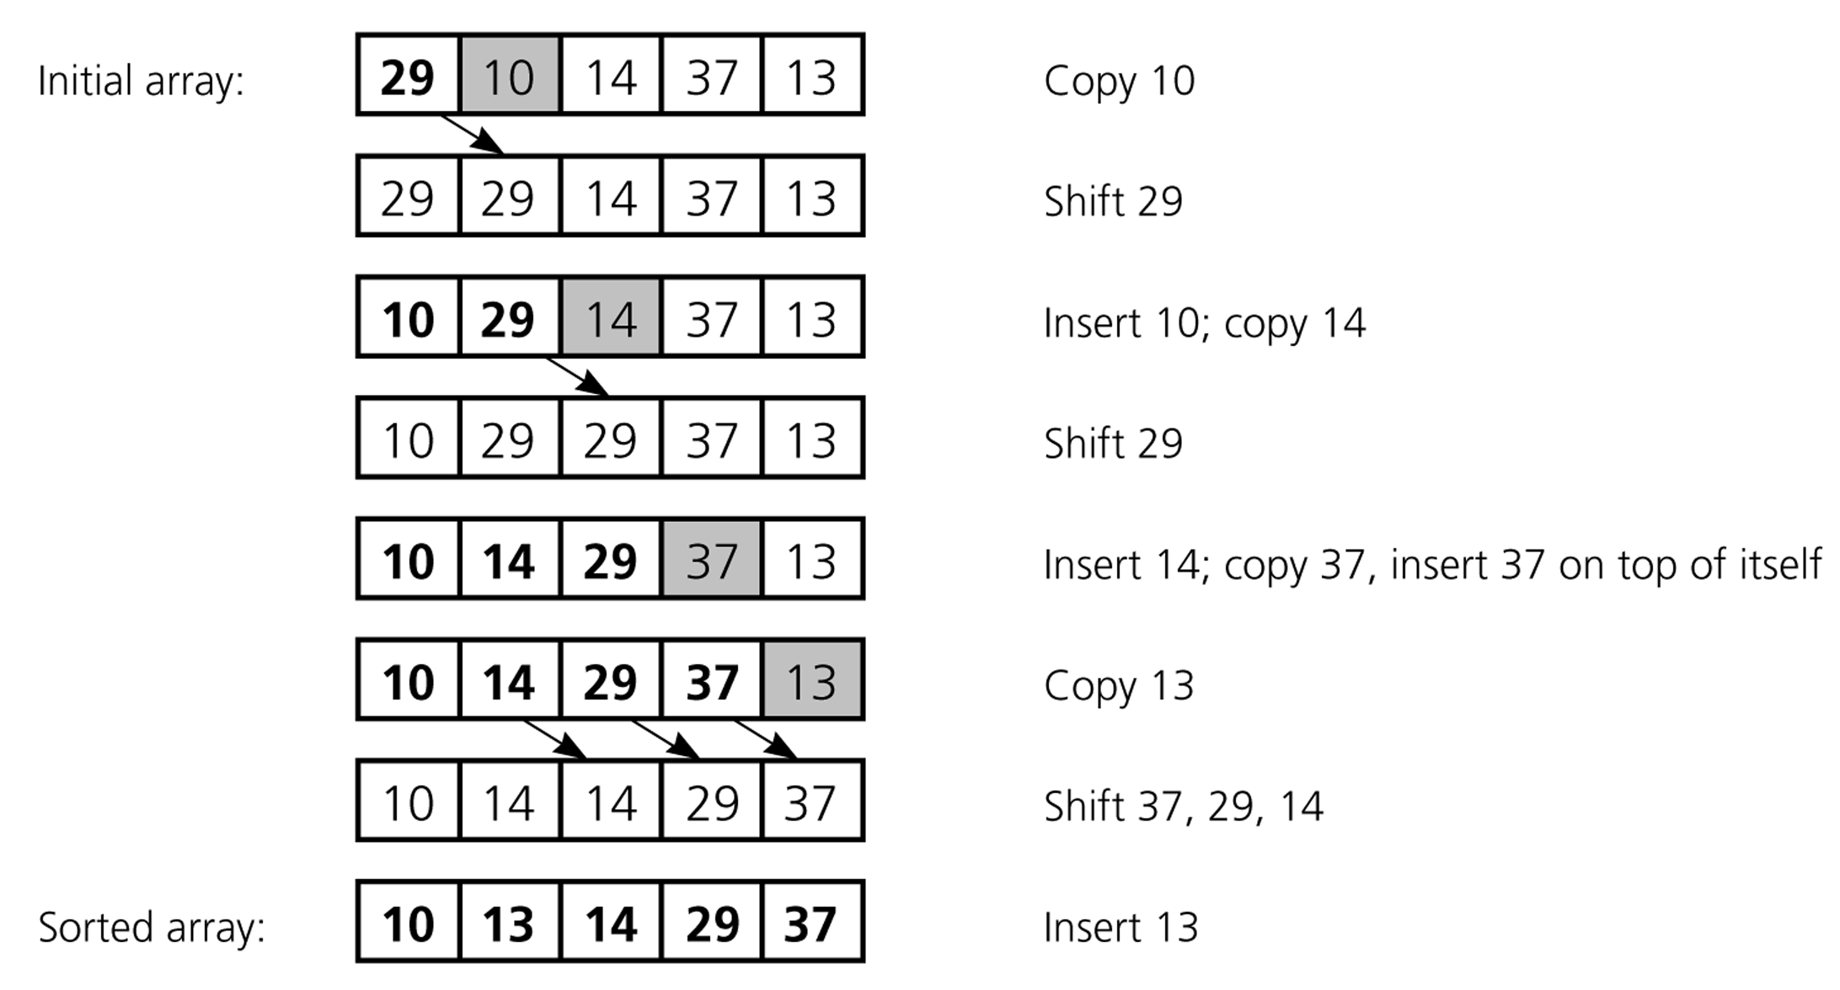
Sorting and Searching (Review)
Fig :An insertion sort of an array of five integers

Slide 15
Sorting and Searching (Review)
Insertion Sort Algorithm
Dpublic void insertionSort(Comparable[] arr) {
for (int i = 1; i < arr.length; ++i) {
Comparable temp = arr[i];
int pos = i;
// Shuffle up all sorted items > arr[i]
while (pos > 0 &&
arr[pos-1].compareTo(temp) > 0) {
arr[pos] = arr[pos–1];
pos--;
} // end while
// Insert the current item
arr[pos] = temp;
}
}

Slide 16
Sorting and Searching (Review)
Insertion Sort Algorithm
public void insertionSort(Comparable[] arr) {
for (int i = 1; i < arr.length; ++i) {
Comparable temp = arr[i];
int pos = i;
// Shuffle up all sorted items > arr[i]
while (pos > 0 &&
arr[pos-1].compareTo(temp) > 0) {
arr[pos] = arr[pos–1];
pos--;
} // end while
// Insert the current item
arr[pos] = temp;
}
}
outer loop
outer times
inner loop
inner times

Slide 17
Sorting and Searching (Review)
Shell sort
Invented by Donald Shell in 1959.
1st algorithm to break the quadratic time barrier but few years later, a sub quadratic time bound was proven.
Shell sort works by comparing elements that are distant rather than adjacent elements in an array.
Shell sort uses a sequence h1, h2, …, ht called the increment sequence. Any increment sequence is fine as long as h1 = 1 and some other choices are better than others.
Shell sort makes multiple passes through a list and sorts a number of equally sized sets using the insertion sort.
Shell sort improves on the efficiency of insertion sort by quickly shifting values to their destination.

Slide 18
Sorting and Searching (Review)
Shellsort is also known as diminishing increment sort.
The distance between comparisons decreases as the sorting algorithm runs until the last phase in which adjacent elements are compared.
After each phase and some increment hk, for every i, we have a[ i ] ≤ a [ i + hk ] all elements spaced hk apart are sorted.
The file is said to be hk – sorted.

Slide 19
Sorting and Searching (Review)
Shell sort Examples
Sort: 18 32 12 5 38 33 16 2
8 Numbers to be sorted, Shell’s increment will be floor(n/2)
Step 1) Only look at 18 and 38 and sort in order; 18 and 38 stays at its current position because they are in order.
Step 2) Only look at 32 and 33 and sort in order; 32 and 33 stays at its current position because they are in order.
* floor(8/2) ➔ floor(4) = 4
1 2 3 4
increment 4:
(visualize underlining)
18 32 12 5 38 33 16 2

Slide 20
Sorting and Searching (Review)
Sort: 18 32 12 5 38 33 16 2
8 Numbers to be sorted, Shell’s increment will be floor(n/2)
* floor(8/2) ➔ floor(4) = 4
1 2 3 4
increment 4:
(visualize underlining)
18 32 12 5 38 33 16 2
Step 3) Only look at 12 and 16 and sort in order; 12 and 16 stays at its current position because they are in order.
Step 4) Only look at 5 and 2 and sort in order; 2 and 5 need to be switched to be in order.

Slide 21
Sorting and Searching (Review)
Sort: 18 32 12 5 38 33 16 2
Resulting numbers after increment 4 pass:
18 32 12 2 38 33 16 5
* floor(4/2) ➔ floor(2) = 2
increment 2:
1 2
18 32 12 2 38 33 16 5
Step 1) Look at 18, 12, 38, 16 and sort them in their appropriate location:
12 38 16 2 18 33 38 5
Step 2) Look at 32, 2, 33, 5 and sort them in their appropriate location:
12 2 16 5 18 32 38 33

Slide 22
Sorting and Searching (Review)
Sort: 18 32 12 5 38 33 16 2
* floor(2/2) ➔ floor(1) = 1
increment 1:
1
12 2 16 5 18 32 38 33
2 5 12 16 18 32 33 38
The last increment or phase of Shell sort is basically an Insertion
Sort algorithm.

Slide 23
Sorting and Searching (Review)
Quick Sort
Given (R0, R1, ... , Rn-1), pick up a pivot key Ki, if Ki is placed in position s(i), then︰
Kj≦Ks(i) for j<s(i)
Kj≧Ks(i) for j>s(i)
R0, …, RS(i)-1, RS(i), RS(i)+1, …, RS(n-1)

Slide 24
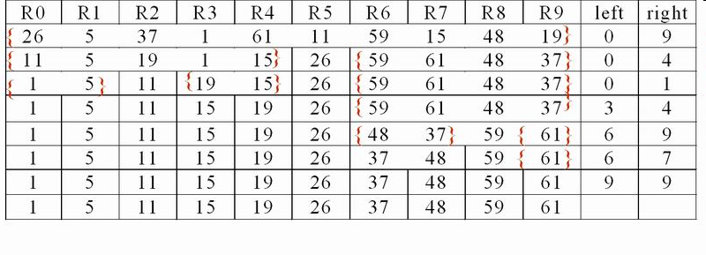
Sorting and Searching (Review)
Quick Sort Example
Given 10 records with keys (26, 5, 37, 1, 61, 11, 59, 15, 48, 19)

Slide 25
Sorting and Searching (Review)
Quick Sort
void quicksort(element list[], int left, int right)
{
int pivot, i, j;
element temp;
if (left < right) {
i = left; j = right+1;
pivot = list[left].key;
do {
do i++; while (list[i].key < pivot);
do j--; while (list[j].key > pivot);
if (i < j) SWAP(list[i], list[j], temp);
} while (i < j);
SWAP(list[left], list[j], temp);
quicksort(list, left, j-1);
quicksort(list, j+1, right);
}
}

Slide 26
Sorting and Searching (Review)
Analysis for Quick Sort
Assume that each time a record is positioned, the list is divided into the rough same size of two parts.
Position a list with n element needs O(n)
T(n) is the time taken to sort n elements T(n)<=cn+2T(n/2) for some c <=cn+2(cn/2+2T(n/4)) ... <=cnlog n+nT(1)=O(nlog n)

Slide 27
Sorting and Searching (Review)
Time complexity:
Worst case: O(n2)
Best case: O(nlogn)
Average case: O(nlogn)
Space complexity
Worst case: O(n)
Best case: O(logn)
Average case: O(logn)
Unstable

Slide 28
Sorting and Searching (Review)
Merge Sort
How to merge two sorted lists (list[i], ... , list[m] and list[m+1], ... , list[n]) into single sorted list, (sorted[i], ... , sorted[n])?
There are two algorithm to do this, one need O(n) space complexity, another only require O(1).

Slide 29
Sorting and Searching (Review)
Merge Sort (O(n) space)
void merge(element list[], element sorted[], int i, int m, int n)
{
int j, k, t;
j = m+1;
k = i;
while (i<=m && j<=n) {
if (list[i].key<=list[j].key)
sorted[k++]= list[i++];
else sorted[k++]= list[j++];
}
if (i>m) for (t=j; t<=n; t++)
sorted[k+t-j]= list[t];
else
for (t=i; t<=m; t++)
sorted[k+t-i] = list[t];
}

Slide 30
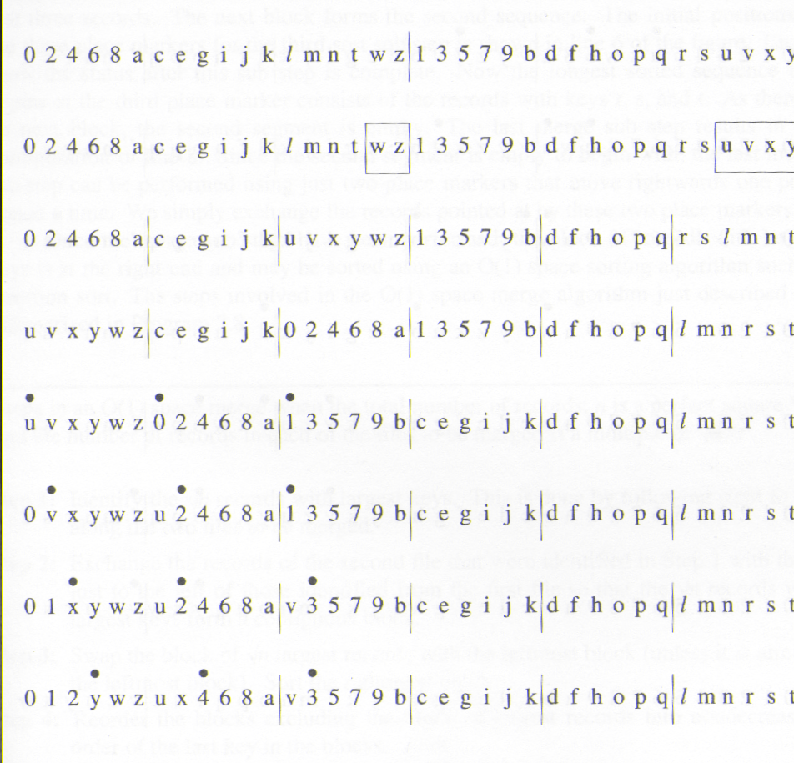
Sorting and Searching (Review)
file 1 (sorted)
file 2 (sorted)
discover
keys
exchange
preprocessing
sort
Sort by the rightmost records of
-1 blocks
exchange
compare
compare
exchange
compare
*Figure 7.5:First eight lines for O(1) space merge example (p337)

Slide 31
Sorting and Searching (Review)
•
•
•
0 1 2 y w z u x 4 6 8 a v 3 5 7 9 b c e g i j k d f h o p q l m n r s t
•
•
•
0 1 2 3 w z u x 4 6 8 a v y 5 7 9 b c e g i j k d f h o p q l m n r s t
•
•
•
0 1 2 3 4 z u x w 6 8 a v y 5 7 9 b c e g i j k d f h o p q l m n r s t
•
•
•
0 1 2 3 4 5 u x w 6 8 a v y z 7 9 b c e g i j k d f h o p q l m n r s t

Slide 32
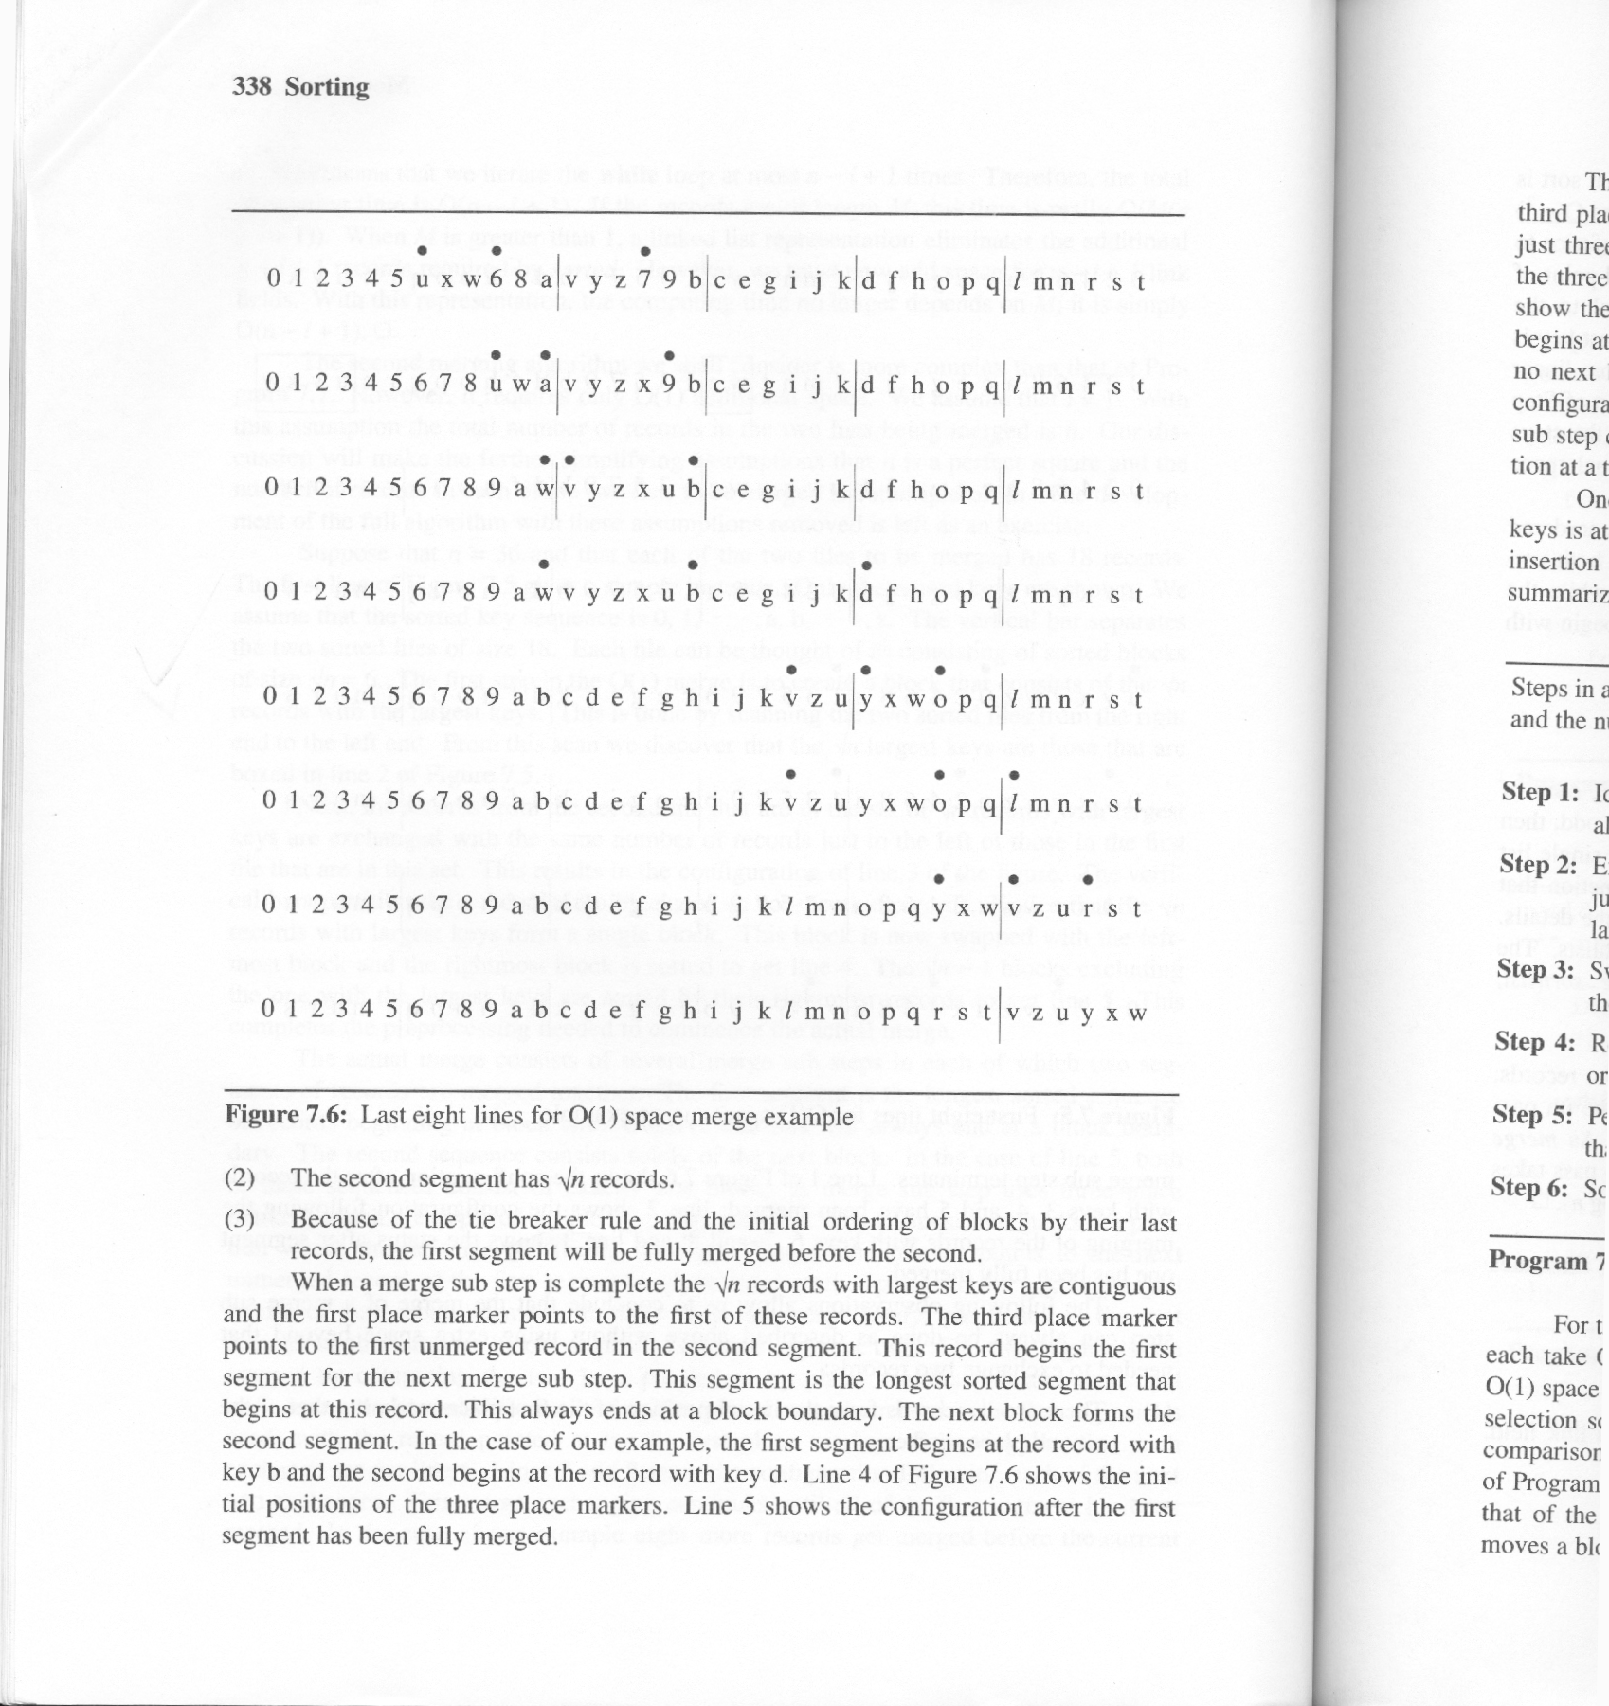
Sorting and Searching (Review)
6, 7, 8 are merged
Segment one is merged (i.e., 0, 2, 4, 6, 8, a)
Change place marker (longest sorted sequence of records)
Segment one is merged (i.e., b, c, e, g, i, j, k)
Change place marker
Segment one is merged (i.e., o, p, q)
No other segment. Sort the largest keys.
*Figure 7.6:Last eight lines for O(1) space merge example(p.338)

Slide 33
Sorting and Searching (Review)
Heap Sort
The heap sort algorithm will require only a fixed amount of additional storage and at the same time will have as its worst case and average computing time O(n log n).
While heap sort is slightly slower than merge sort using O(n) additional space, it is faster than merge sort using O(1) additional space.

Slide 34
Sorting and Searching (Review)
Heap Sort Example
[1]
26
[2]
5
[3]
77
[4]
1
[5]
61
[6]
11
[7]
59
[8]
15
[9]
48
[10]
19
Array interpreted as a binary tree

Slide 35
Sorting and Searching (Review)
initial heap
[1]
77
[2]
61
[3]
59
exchange
[4]
48
[5]
19
[6]
11
[7]
26
[8]
15
[9]
1
[10]
5
Max heap following first for loop of heapsort

Slide 36
Sorting and Searching (Review)
[1]
61
[2]
48
[3]
59
[4]
15
[5]
19
[6]
11
[7]
26
[8]
5
[9]
1
[10]
77

Slide 37
Sorting and Searching (Review)
[1]
59
[2]
48
[3]
26
[4]
15
[5]
19
[6]
11
[7]
1
[8]
5
[9]
61
[10]
77

Slide 38
Sorting and Searching (Review)
[1]
48
[2]
19
[3]
26
[4]
15
[5]
5
[6]
11
[7]
1
[8]
59
[9]
61
[10]
77

Slide 39
Sorting and Searching (Review)
[1]
26
[2]
19
[3]
11
[4]
15
[5]
5
[6]
1
[7]
48
[8]
59
[9]
61
[10]
77

Slide 40
Sorting and Searching (Review)
Heap Sort
void adjust(element list[], int root, int n)
{
int child, rootkey; element temp;
temp=list[root]; rootkey=list[root].key;
child=2*root;
while (child <= n) {
if ((child < n) && (list[child].key < list[child+1].key)) child++;
if (rootkey > list[child].key) break;
else {
list[child/2] = list[child];
child *= 2;
}
}
list[child/2] = temp;
}
2i

Slide 41
Sorting and Searching (Review)
Heap Sort Example
void heapsort(element list[], int n)
{
int i, j;
element temp;
for (i=n/2; i>0; i--) adjust(list, i, n);
for (i=n-1; i>0; i--) {
SWAP(list[1], list[i+1], temp);
adjust(list, 1, i);
}
}
ascending order (max heap)
bottom-up
n-1 cylces
top-down

Slide 42
Sorting and Searching (Review)
Radix Sort
We now examine the problem of sorting records that have several keys.
These keys are labeled K0,K1, ... ,Kr-1, with K0 be the most significant key and Kr-1 the least.
R0, ... ,Rn-1, is lexically sorted with respect to the keys K0,K1, ... ,Kr-1 iff
, 0≦i<n-1

Slide 43
Sorting and Searching (Review)
We now examine the problem of sorting records that have several keys.
These keys are labeled K⁰,K¹, ... ,K^{r-1}, with K⁰ be the most significant key and K^{r-1} the least.
R₀, ... ,R_{n-1}, is lexically sorted with respect to the
keys K⁰,K¹, ... ,K^{r-1} iff
, 0≦i<n-1
Most significant digit first: sort on K0, then K1, ...
Least significant digit first: sort on Kr-1, then Kr-2, ...

Slide 44
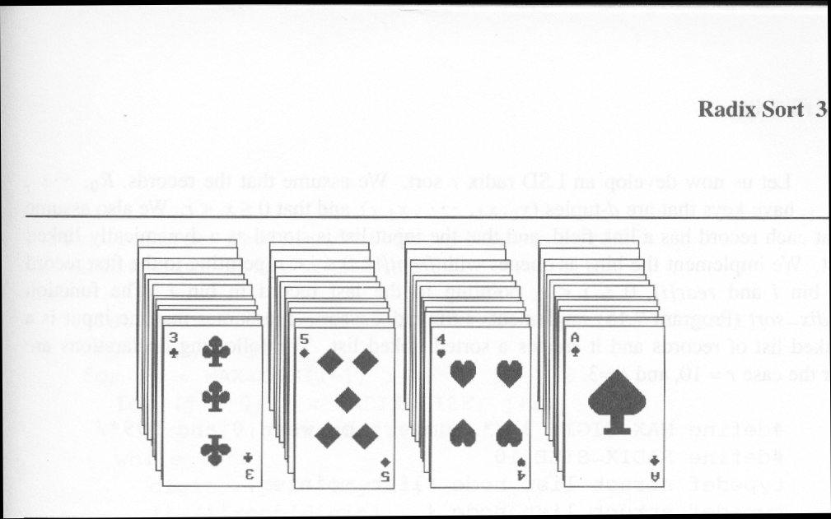
Arrangement of cards after first pass of an MSD sort
Sorting and Searching (Review)
Suits: ♣ < ♦ < ♥ < ♠
Face values: 2 < 3 < 4 < … < J < Q < K < A
(1) MSD sort first, e.g., bin sort, four bins ♣ ♦ ♥ ♠
LSD sort second, e.g., insertion sort
(2) LSD sort first, e.g., bin sort, 13 bins
2, 3, 4, …, 10, J, Q, K, A
MSD sort, e.g., bin sort four bins ♣ ♦ ♥ ♠

Slide 45
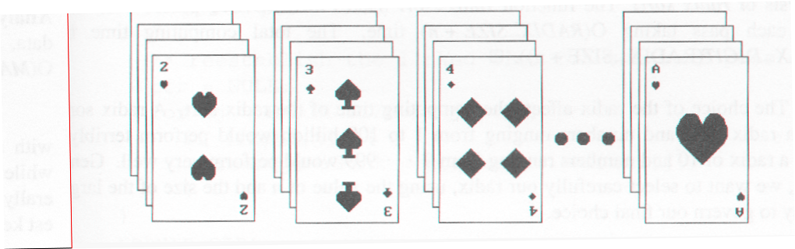
Arrangement of cards after first pass of an LSD sort
Sorting and Searching (Review)

Slide 46
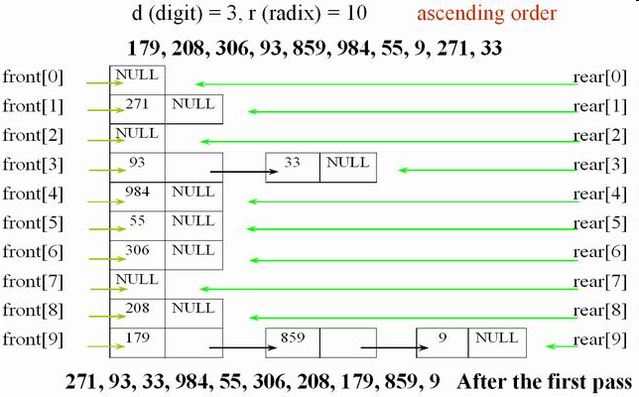
Sorting and Searching (Review)
LSD radix sort example

Slide 47
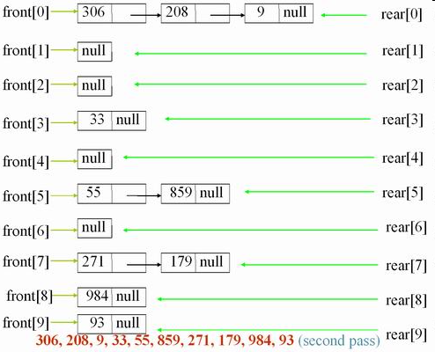
Sorting and Searching (Review)

Slide 48
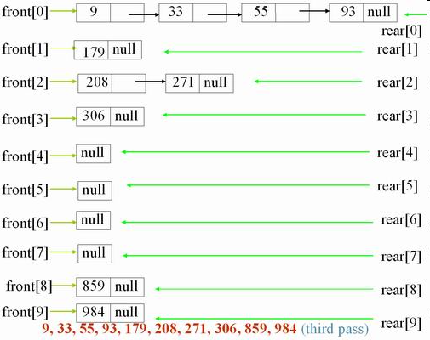
Sorting and Searching (Review)

Slide 49
Sorting and Searching (Review)
LSD radix sort
An LSD radix r sort,
R0, R1, ..., Rn-1 have the keys that are d-tuples (x0, x1, ..., xd-1)
#define MAX_DIGIT 3
#define RADIX_SIZE 10
typedef struct list_node *list_pointer;
typedef struct list_node {
int key[MAX_DIGIT];
list_pointer link;
}

Slide 50
Sorting and Searching (Review)
list_pointer radix_sort(list_pointer ptr)
{
list_pointer front[RADIX_SIZE], rear[RADIX_SIZE];
int i, j, digit;
for (i=MAX_DIGIT-1; i>=0; i--) {
for (j=0; j<RADIX_SIZE; j++)
front[j]=read[j]=NULL;
while (ptr) {
digit=ptr->key[I];
if (!front[digit]) front[digit]=ptr;
else rear[digit]->link=ptr;
Initialize bins to be
empty queue.
Put records into queues.

Slide 51
Sorting and Searching (Review)
rear[digit]=ptr;
ptr=ptr->link;
}
/* reestablish the linked list for the next pass */
ptr= NULL;
for (j=RADIX_SIZE-1; j>=0; j++)
if (front[j]) {
rear[j]->link=ptr;
ptr=front[j];
}
}
return ptr;
}
Get next record.
O(n)
O(d(n+r))
O(r)

Slide 52
Sorting and Searching (Review)
Self Assessment Questions
Which of the following is not a stable sorting algorithm?
Insertion sort
Selection sort
Bubble sort
Merge sort
Answer: b)
Notes:
1. b)

Slide 53
Sorting and Searching (Review)
If the given input array is sorted or nearly sorted, which of the following algorithm gives the best performance?
Insertion sort
Selection sort
Quick sort
Merge sort
Answer: a)
Notes:
2. a)

Slide 54
Sorting and Searching (Review)
3. Which of the following algorithm pays the least attention to the ordering of the elements in the input list?
Insertion sort
Selection sort
Quick sort
None
Answer: b)
Notes:
3. b)

Slide 55
Sorting and Searching (Review)
Document Links
Topics | URL | Notes
Sorting Techniques | https://www.geeksforgeeks.org/sorting-algorithms/ | This link explains about different sorting techniques

Slide 56
Sorting and Searching (Review)
Video Links
Topics | URL | Notes
Sorting Techniques | https://www.youtube.com/watch?v=8BI2MNnwrKI | This video explains about different sorting techniques

Slide 57
Sorting and Searching (Review)
SEARCHING ALGORITHMS

Slide 58
Sorting and Searching (Review)
Problem : Search
We are given a list of records.
Each record has an associated key.
Give efficient algorithm for searching for a record containing a particular key.
Efficiency is quantified in terms of average time analysis (number of comparisons) to retrieve an item.

Slide 59
Sorting and Searching (Review)
Search
Each record in list has an associated key.
In this example, the keys are ID numbers.
Given a particular key, how can we efficiently retrieve the record from the list?
[ 0 ]
[ 1 ]
[ 2 ]
[ 3 ]
[ 4 ]
[ 700 ]
…
Number 701466868
Number 281942902
Number 233667136
Number 580625685
Number 506643548
Number 155778322
Number 580625685

Slide 60
Sorting and Searching (Review)
Linear Search
Step through array of records, one at a time.
Look for record with matching key.
Search stops when
record with matching key is found.
or when search has examined all records without success.

Slide 61
Sorting and Searching (Review)
Pseudocode for Linear Search
// Search for a desired item in the n array elements
// starting at a[first].
// Returns pointer to desired record if found.
// Otherwise, return NULL
…
for(i = first; i < n; ++i )
if(a[first+i] is desired item)
return &a[first+i];
// if we drop through loop, then desired item was not found
return NULL;

Slide 62
Sorting and Searching (Review)
Linear Search Analysis
What are the worst and average case running times for Linear search?
We must determine the O-notation for the number of operations required in search.
Number of operations depends on n, the number of entries in the list.

Slide 63
Sorting and Searching (Review)
Worst Case Time for Linear Search
For an array of n elements, the worst case time for Linear search requires n array accesses: O(n).
Consider cases where we must loop over all n records:
desired record appears in the last position of the array.
desired record does not appear in the array at all.

Slide 64
Sorting and Searching (Review)
Average Case for Linear Search
Assumptions:
All keys are equally likely in a search
We always search for a key that is in the array
Example:
We have an array of 10 records.
If search for the first record, then it requires 1 array access; if the second, then 2 array accesses. etc.
The average of all these searches is:
(1+2+3+4+5+6+7+8+9+10)/10 = 5.5

Slide 65
Sorting and Searching (Review)
Generalize for array size n.
Expression for average-case running time:
(1+2+…+n)/n = n(n+1)/2n = (n+1)/2
Therefore, average case time complexity for Linear search is O(n).

Slide 66
Sorting and Searching (Review)
Binary Search
Perhaps, can we do better than O(n) in the average case?
Assume that we are give an array of records that is sorted. For instance:
an array of records with integer keys sorted from smallest to largest (e.g., ID numbers), or
an array of records with string keys sorted in alphabetical order (e.g., names).

Slide 67
Sorting and Searching (Review)
Binary Search Pseudocode
…
if(size == 0)
found = false;
else {
middle = index of approximate midpoint of array segment;
if(target == a[middle])
target has been found!
else if(target < a[middle])
search for target in area before midpoint;
else
search for target in area after midpoint;
}
…

Slide 68
Sorting and Searching (Review)
Binary Search
Example: sorted array of integer keys. Target=7.
[ 0 ]
[ 1 ]
[ 2 ]
[ 3 ]
[ 4 ]
[ 5 ]
[ 6 ]
3
6
7
11
32
33
53

Slide 69
Sorting and Searching (Review)
[ 0 ]
[ 1 ]
[ 2 ]
[ 3 ]
[ 4 ]
[ 5 ]
[ 6 ]
3
6
7
11
32
33
53
Find approximate midpoint

Slide 70
Sorting and Searching (Review)
[ 0 ]
[ 1 ]
[ 2 ]
[ 3 ]
[ 4 ]
[ 5 ]
[ 6 ]
3
6
7
11
32
33
53
Is 7 = midpoint key? NO.

Slide 71
Sorting and Searching (Review)
[ 0 ]
[ 1 ]
[ 2 ]
[ 3 ]
[ 4 ]
[ 5 ]
[ 6 ]
3
6
7
11
32
33
53
Is 7 < midpoint key? YES.

Slide 72
Sorting and Searching (Review)
[ 0 ]
[ 1 ]
[ 2 ]
[ 3 ]
[ 4 ]
[ 5 ]
[ 6 ]
3
6
7
11
32
33
53
Search for the target in the area before midpoint.

Slide 73
Sorting and Searching (Review)
[ 0 ]
[ 1 ]
[ 2 ]
[ 3 ]
[ 4 ]
[ 5 ]
[ 6 ]
3
6
7
11
32
33
53
Find approximate midpoint

Slide 74
Sorting and Searching (Review)
[ 0 ]
[ 1 ]
[ 2 ]
[ 3 ]
[ 4 ]
[ 5 ]
[ 6 ]
3
6
7
11
32
33
53
Target = key of midpoint? NO.

Slide 75
Sorting and Searching (Review)
[ 0 ]
[ 1 ]
[ 2 ]
[ 3 ]
[ 4 ]
[ 5 ]
[ 6 ]
3
6
7
11
32
33
53
Target < key of midpoint? NO.

Slide 76
Sorting and Searching (Review)
[ 0 ]
[ 1 ]
[ 2 ]
[ 3 ]
[ 4 ]
[ 5 ]
[ 6 ]
3
6
7
11
32
33
53
Target > key of midpoint? YES.

Slide 77
Sorting and Searching (Review)
[ 0 ]
[ 1 ]
[ 2 ]
[ 3 ]
[ 4 ]
[ 5 ]
[ 6 ]
3
6
7
11
32
33
53
Search for the target in the area after midpoint.

Slide 78
Sorting and Searching (Review)
[ 0 ]
[ 1 ]
[ 2 ]
[ 3 ]
[ 4 ]
[ 5 ]
[ 6 ]
3
6
7
11
32
33
53
Find approximate midpoint.
Is target = midpoint key? YES.

Slide 79
Sorting and Searching (Review)
Self Assessment Questions
4. Binary search algorithm cannot be applied to _____.
sorted linked list
sorted binary trees
sorted linear array
pointer array
Answer: d)
Notes:
4. d)

Slide 80
Sorting and Searching (Review)
5. Complexity of linear search algorithm is ………
O(n)
O(logn)
O(n2)
O(n logn)
Answer: b)
Notes:
5. b)

Slide 81
Sorting and Searching (Review)
Assignment
Three sum. Given an array of n integers, design an algorithm to determine whether any three of them sum to 0. The order of growth of the running time of your program should be n2 log n. Extra credit: Develop a program that solves the problem in quadratic time.
Quicksort. Write a recursive program that sorts an array of Comparable objects by using, as a subroutine, the partitioning algorithm described in the previous exercise: First, pick a random element v as the partitioning element. Next, partition the array into a left subarray containing all elements less than v, followed by a middle subarray containing all elements equal to v, followed by a right subarray containing all elements greater than v. Finally, recursively sort the left and right subarrays.
Reverse domain. Write a program to read in a list of domain names from standard input, and print the reverse domain names in sorted order. For example, the reverse domain of cs.princeton.edu is edu.princeton.cs. This computation is useful for web log analysis.
Local minimum in an array. Given an array a[] of n real numbers, design a logarithmic-time algorithm to find a local minimum (an index i such that both a[i-1] < a[i] and a[i] < a[i+1]).

Slide 82
Sorting and Searching (Review)
Document Links
Topics | URL | Notes
Searching and Sorting Algorithms | https://www.tutorialspoint.com/data_structures_algorithms/data_structures_algorithms_tutorial.pdf | This link explains about different searching and sorting algorithms

Slide 83
Sorting and Searching (Review)
Video Links
Topics | URL | Notes
Searching Algorithms | https://www.geeksforgeeks.org/searching-algorithms/ | This link explains about different searching algorithms

Slide 84
Sorting and Searching (Review)
E-Book Links
Topics | URL | Notes
Searching and Sorting Algorithms | https://www.tutorialspoint.com/data_structures_algorithms/data_structures_algorithms_tutorial.pdf | This link explains about different searching and sorting algorithms

